Slide 1
Clinical Microbiology Cases
AUTONOMOUS UNIVERSITY OF SAN LUIS POTOSÍ
FACULTY OF CHEMICAL SCIENCE
MICROBIOLOGY LABORATORY
Intraabdominal abscess by Proteus mirabilis, producer of a plasmid AmpC beta-lactamase type ACC.
Student: Hernández López Marisol
Teacher: Q.F.B. Juana Tovar Oviedo
Group: 11:00 – 12:00

Slide 2
objective
To know the tests performed for the correct identification of a microorganism, in addition to the mechanisms of common use used in the treatment of infectious diseases.
Introduction
Proteus mirabilis is a gram negative bacillus, belonging to the family of enterobacteria, facultatively anaerobic. It shows agglutination, motility, and urease activity. P. mirabilis causes 90% of all 'Proteus' infections. It comes from the Proteae Tribe.

Slide 3
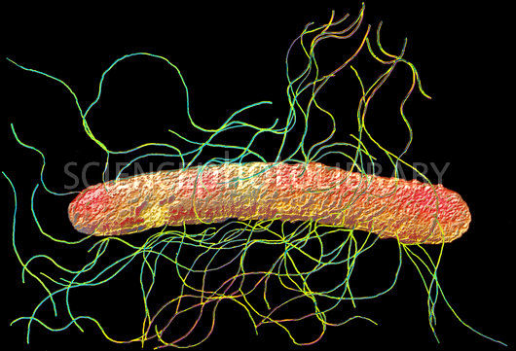
Domain: Bacteria
Phylum: Proteobacteria
Class: Gammaproteobacteria
Order: Enterobacteriales
Family: Enterobacteriaceae
Genus: Proteus
Species: Proteus mirabilis

Slide 4
Methodology
Observation of the environment in which growth occurred
It contains indicator substances that allow to demonstrate the metabolic activity of M.O that distinguishes it
Growing medium: Mac Conkey agar
Specifications: Selective medium and differential
Observation: No colonization was carried out
Conclusion: Fermentation of lactose NEGATIVE
This culture medium is used for the isolation and differentiation of lactose fermenting and non-fermenting Gram negative bacilli.
It favors the growth of specific M.O and suppresses the growth of others

Slide 5
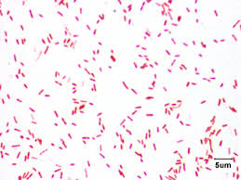
Gram staining of different colonies
Staining: NEGATIVE
Bacterial morphology identified: Bacilli grouped in pairs and chain
Consistent test: Oxidase

Slide 6
Test of oxidase
Result obtained by adding hydrochloride of
P-phenylenediamine
Positive control
(Pseudomone)
This test detects the presence of cytochrome oxidase, which reduces O 2 and artificial electron acceptors.
Result: NEGATIVE
Conclusion: Enterobacteria
Tests to be performed: Biochemicals for enterobacteria

Slide 7
Biochemical tests

Slide 8
Description
A 59-year-old woman with a history of ulcerative colitis who underwent a colectomy to control her underlying disease. On the sixth postoperative day, the onset of high fever and deterioration of the general state of rapid evolution. Empirical treatment with ceftazidime, metronidazole and vancomycin is initiated. In the 2 blood cultures extracted, a gram-negative bacillus, fermentor, identified as Proteus mirabilis grows. Such insulation is shown to be RESISTANT to amoxicillin / clavulanic acid, cefotaxime, ceftazidime and aminoglycosides, but is SENSITIVE to ampicillin, cefoxitin, fluoroquinolones and carbapenems. As an additional diagnostic test, a computerized axial tomography is performed in which a low density abdominal tissue mass and a well-defined capsule are detected. Antibiotic treatment with meropenem and ciprofloxacin is initiated and percutaneous drainage is performed under image control of the abscess. Blood cultures were negativized at two days and the patient progressed favorably towards healing.

Slide 9
What is the possible clinical diagnosis of the case presented and the etiologic agents to be covered with empiric antibiotic treatment?
Intraabdominal abscesses can be classified into: (1) acquired in the community, corresponding to evolved intra-abdominal infections; And (2) postoperative, which occur in the first days after a surgical intervention. The presence of a febrile syndrome after a laparotomy, especially if there has been a previous interval of days without fever in the postoperative period, should make suspicion of abscess formation. Up to 25% of intraabdominal abscesses may be accompanied by bacteremia. The radiological image obtained by computerized axial tomography was compatible with the presence of an abscess. Therefore, the diagnosis of the case presented here was that of an intraabdominal abscess associated with bacteremia in a postoperative process. Intra-abdominal abscesses usually have a polymicrobial etiology, which includes usual intestinal flora such as gram-negative bacilli (mainly enterobacteriaceae such as Escherichia coli or non-fermenting gram-negative bacilli such as Pseudomonas aeruginosa), anaerobes (mainly Bacteroides fragilis) and enterococci (mainly Enterococus faecalis). In addition to E. coli, other enterobacteria that are usually involved in intraabdominal abscesses are Klebsiella, Enterobacter, Citrobacter and Proteus species.

Slide 10
What molecular mechanisms can generate a profile of beta-lactam antibiotic resistance as presented by the isolated strain?
The beta-lactam antibiotic resistance profile of the P. mirabilis strain of this case showed that resistance to cephalosporins of the third generation, such as cefotaxime and ceftazidime, was more relevant. The two mechanisms of resistance that could explain this profile are the extended spectrum beta-lactamases (BLEE) and the AmpC type cephalosporinases. The BLEEs present the in vitro sensitivity to cefoxitin and amoxicline / clavulanic acid and the recovery of the activity of the 3rd generation cephalosporins in the presence of clavulanic acid. Failure to recover such activity and resistance to amoxicillin / clavulanic acid would be in favor of an AmpC. However, in practice, many isolates of BLEE producing enterobacteria are resistant to amoxicillin / clavulanic acid and to cefoxitin by the presence of other associated mechanisms such as alterations of porins or production of OXA-1. In the P. mirabilis strain at hand, cefotaxime and ceftazidime activity was not recovered with clavulanic acid, so all phenotypic data (except for cefoxitin sensitivity) led to the production of a cephalosporinase of the AmpC type

Slide 11
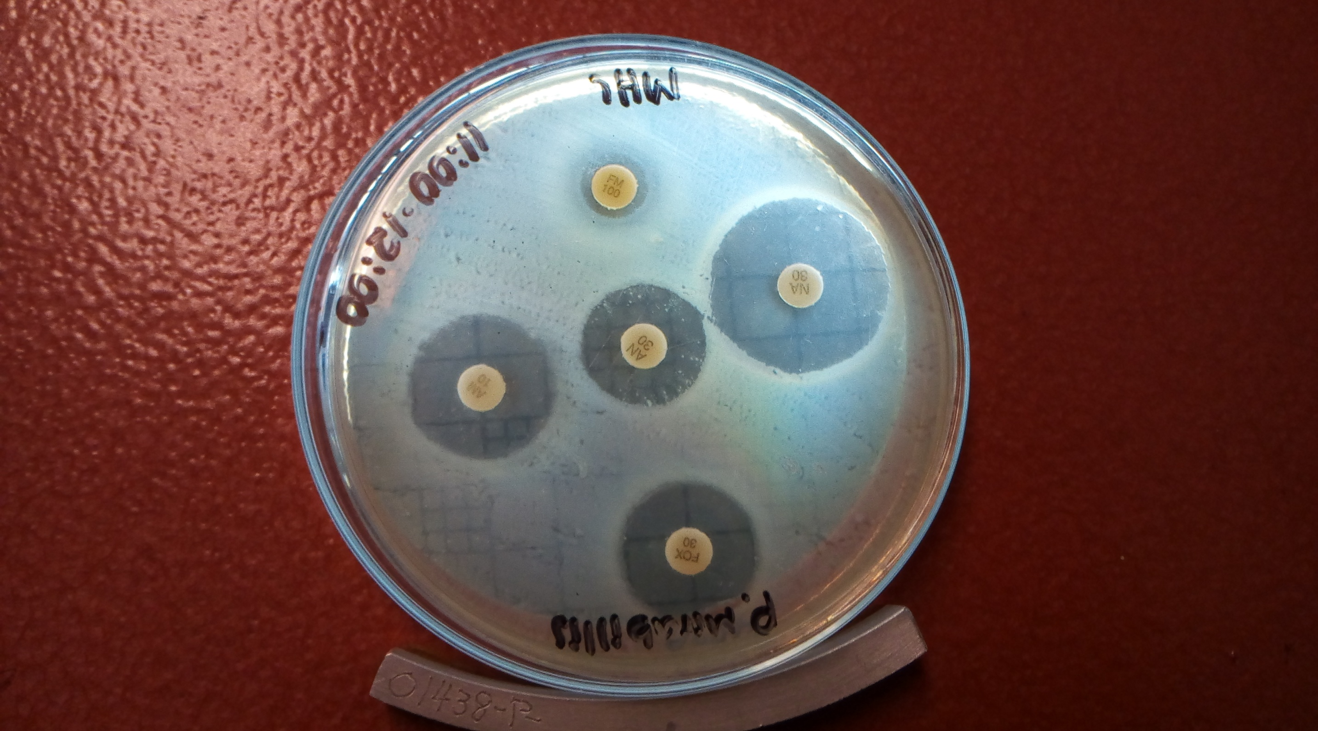
Susceptible to: CEFOXITIN (FOX-30)
AMIKACIN (AN-30)
AMPICILLIN (AM-10)
NALIDIXIC ACID (NA-30)
Resistant to:
FURAZOLIDONE (FM-100)

Slide 12
CONCLUSIONS
In developing this research, I understood that it is extremely important to be able to correctly identify a microorganism, since the mechanisms of infection of these organisms are very different based on their species. Knowing this point, it is important to know how the antibiotics act since this way a disease can be followed, and this can be identified thanks to the method of diffusion of Kirby - Bauer
Bibliography
Bou G, Oliver A, Ojeda M, et al. Molecular characterization of FOX-4, a new AmpC-type plasmid-mediated betalactamase from an E. coli strain isolated in Spain. Antimicrob Agents Chemother 2000; 44: 2549-53.
Navarro F, Pérez-Trallero E, Marimón JM, et al. CMY-2-producing Salmonella enterica, Klebsiella pneumoniae, Klebsiella oxytoca, Proteus mirabilis and Escherichia coli strains isolated in Spain. J Antimicrob Chemother 2001; 48: 383-9.

